Slide 1
UNIT IVE
INFLATION

Slide 2
INFLATION
Inflation is an increase in the overall price level (INCREASE IN THE BASKET OF GOODS AND SERVICES) over a period of time{usually a year}.
The condition of a substantial and rapid increase in the general price level which causes a decline in the purchasing power of money.

Slide 3
Consumer price inflation is the rate at which
the prices of goods and services bought by
households rise or fall. A convenient way of
thinking about this is to imagine a very large
‘shopping basket’ containing those goods and
services bought by households. As the prices
of the various items in the basket change over
time, so does the total cost of the basket.

Slide 4
Movements in consumer price inflation
indices represent the changing cost of the
shopping basket.
In principle, the basket should contain all
consumer goods and services purchased by
households and the prices measured in every
shop or outlet that supplies them.

Slide 5
COMPONENTS OF THE BASKET OF GOODS AND SERVICES
Allocation of items to CPI divisions in 2014
CPI OBSERVED RESPRESENTATIVE
Weight % VARIATION IN PRICE ITEMS % OF TATAL
CHANGED
Food & non-alcoholic beverages 11.2 HIGH 23
Alcohol & tobacco 4.5 LOW 4
Clothing & footwear 7.2 MEDIUM 11
Housing & household services 12.9 MEDIUM 5
Furniture & household goods 6.0 MEDIUM 10
Health 2.4 MEDIUM 3
Transport 15.2 MEDIUM 6

Slide 6
COMPONENTS OF THE BASKET OF GOODS AND SERVICES
Allocation of items to CPI divisions in 2014
CPI OBSERVED RESPRESENTATIVE
Weight % VARIATION IN PRICE ITEMS % OF TATAL
CHANGED
Communication 3.2 HIGH 1
Recreation & culture 14.4 HIGH 17
Education 2.2 HIGH 1
Restaurants & hotels 12.0 LOW 8
Miscellaneous goods &
Services 8.8 HIGH 11

Slide 7
FEATURES OF INFLATION
Inflation is always accompanied by the rise in price level.
Inflation is a monetary phenomenon and is generally caused by excessive money supply.
Pure inflation starts after full employment.
Inflation may be demand pull or cost push.
Excessive demand in relation to the supply of everything is the essence of inflation.

Slide 8
TYPES AND CAUSES INFLATION

Slide 9
TYPES & CAUSES OF INFLATION
Demand Pull inflation
This type of inflation results due to the increase in Aggregate demand in the economy. The movement of aggregate demand from AD₀ to AD₁ results in an increased average price level in the economy

Slide 10
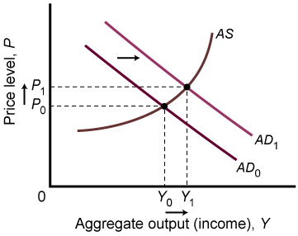
TYPES OF INFLATION {Demand Pull inflation}

Slide 11
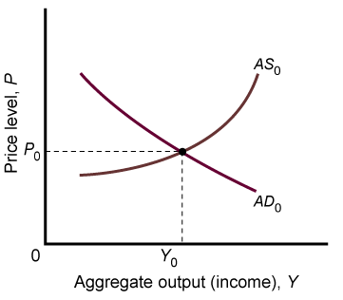
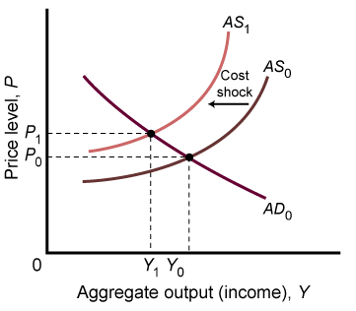
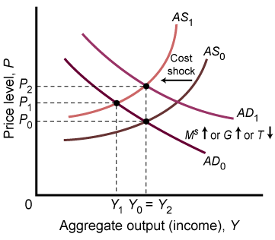
Cost-Push, or Supply-Side Inflation
Stagflation occurs when output is falling at the same time that prices are rising.
One possible cause of stagflation is an increase in costs.

Slide 12
Cost-Push, or Supply-Side Inflation
Cost shocks are bad news for policy makers. The only way to counter the output loss is by having the price level increase even more than it would without the policy action.

Slide 13
Increase in cost of production will result in cost push inflation. As the cost of production increases, the firms will reduce supply. The aggregate supply will shift to the left, from AS₀ to AS₁. This will result in an increase in the average price level in the economy. Real output will fall.

Slide 14
INFLATIONARY SPIRAL
It is self-sustaining upward trend in general price levels due to interaction of demand pull and cost push inflation. It is also known as Wage price spiral.

Slide 15
CAUSES OF INFLATION
Demand pull inflation is caused due to the changes in
the determinants of AD. Whenever, any of the
components of AD will increase, this will result in an
increase in aggregate demand:
consumption
investment
government spending
net exports

Slide 16
CAUSES OF INFLATION
Cost Push inflation is mainly caused due
to the following factors:
increase in wages (wage push inflation)
increase in cost of raw materials
increased cost of imported components (import-push inflation)

Slide 17
CAUSES OF INFLATION
High cost of living prompts demands for higher wages which push production costs up forcing firms to increases prices, which in turn trigger calls for fresh wage increases {INFLATIONARY SPIRAL}

Slide 18
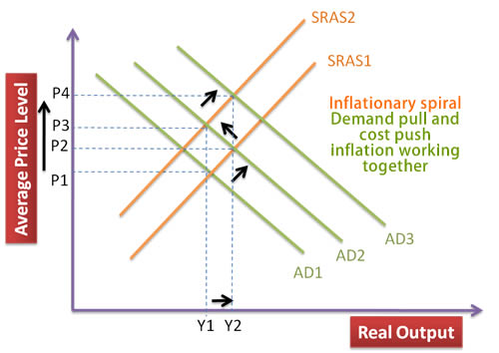

Slide 19
MONETARISTS VIEW OF INFLATION
.
.
.
As per monetarists (new classical economists) inflation is caused due to the excessive supply of money in the economy. According to monetarists an increase in money supply results in higher aggregate demand from. Monetarists assume the economy to operate as full employment level of output, thus, any increase in AD is purely inflationary.

Slide 20
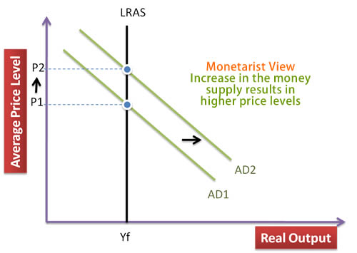
MONETARISTS VIEW OF INFLATION

Slide 21
Table 2.8.1: Annual inflation rates (1990 – 2010)
Year | Inflation Rate (%) | Average Interest Rate (%) | Year | Inflation Rate (%) |  | Average Interest Rate (%)
1990 | 29.80 | 34.50 | 2001 | 8.50 |  | 32.76
1991 | 80.20 | 35.78 | 2002 | 7.30 |  | 30.50
1992 | 40.24 | 53.49 | 2003 | 14.10 |  | 28.67
1993 | 30.10 | 51.33 | 2004 | 10.30 |  | 28.67
1994 | 26.80 | 62.34 | 2005 | 12.40 |  | 17.28
1995 | 25.60 | 50.26 | 2006 | 15.30 |  | 17.67
1996 | 15.80 | 57.99 | 2007 | 5.80 |  | 17.20
1997 | 9.20 | 45.32 | 2008 | 9.50 |  | 16.83
1998 | 7.90 | 41.74 | 2009 | 22.00 |  | 16.43
1999 | 6.80 | 36.90 | 2010 | 9.60 |  | 16.83
2000 | 6.10 | 32.90

Slide 22
RESEARCH ASSIGNMENT
RESEARCH THE INFLATION OF JAMAICA BETWEEN 2011 AND 2014. USE THE AND EXPLAIN HOW PRICES OF GOODS AND SERVICES CHANGE DURING THE SAME PERIOD.

Slide 23
CONTROLLING INFLATION
Inflation can be controlled with the
implementation of:
Fiscal policies {increase taxation or
reduced government spending or both
simultaneously}
Monetary policies {increase interest rate and slow or reduce monetary supply}

Slide 24
FISCAL POLICIES
The government can increase taxes (such as
income tax and VAT) and cut spending. This
improves the budget situation and helps to
reduce demand in the economy.
Both these policies reduce inflation by reducing
growth of Aggregate Demand.

Slide 25
An economy that is growing strongly can apply this fiscal policy without causing a recession.
An economy with high inflation and negative growth, then reduce aggregate demand would be more unpalatable as reducing inflation would lead to lower output and higher unemployment. They could still reduce inflation, but, it would be much more damaging to the economy.

Slide 26
MONETARISM {monetary policies}
Monetarism seeks to control inflation through controlling the money supply. Monetarists believe there is a strong link between the money supply and inflation. If you can control the growth of the money supply, then you should be able to bring inflation under control.

Slide 27
Monetarists would stress policies such as:
higher interest rates (tightening monetary policy)
reducing budget deficit (deflationary fiscal policy)
Control of money being created by government
However, in practise, the link between money supply and inflation is less strong.

Slide 28
OTHER POLICIES TO REDUCE INFLATION
WAGE CONTROL
If inflation is caused by wage inflation (e.g. powerful unions bargaining for higher real wages), then limiting wage growth can help to moderate inflation. Lower wage growth helps to reduce cost push inflation, and helps to moderate demand pull inflation.

Slide 29
However, as the UK discovered in the 1970s, it can be difficult to control inflation through incomes policies, especially if the unions are powerful.

Slide 30
Supply Side Policies
Often inflation is caused by persistent uncompetitiveness and rising costs. Supply side policies may enable the economy to become more competitive and help to moderate inflationary pressures. For example, more flexible labour markets may help reduce inflationary pressure. However, supply side policies can take a long time, and cannot deal with inflation caused by rising demand.

Slide 31
WAYS TO REDUCE HYPERINFLATION
In a period of hyperinflation, conventional policies may be unsuitable. Expectations of future inflation may be hard to change. When people have lost confidence in a currency, it may be necessary to introduce a new currency or use another like the dollar (e.g.Zimbabwe hyperinflation).

Slide 32
WAYS TO REDUCE COST PUSH INFLATION
Cost push inflation (e.g. rising oil prices can lead to inflation, but, also lower growth. This is the worst of both worlds, and is more difficult to control without leading to lower growth.

